Slide 1
3: IPv6 Address Representation and Address Types
Rick Graziani
Cabrillo College
Rick.Graziani@cabrillo.edu

Slide 2
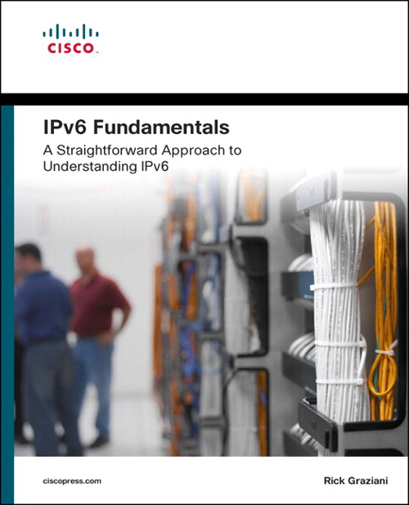
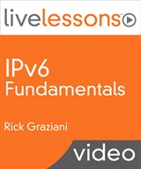
For more information please check out my Cisco Press book and video series:
IPv6 Fundamentals: A Straightforward Approach to Understanding IPv6
By Rick Graziani
ISBN-10: 1-58714-313-5
IPv6 Fundamentals LiveLessons: A Straightforward Approach to Understanding IPv6
By Rick Graziani
ISBN-10: 1-58720-457-6

Slide 3
3.1: Understanding Hexadecimal Numbers

Slide 4
Simple Number System Rules
For all number systems, the first digit is 0
A Base-n number system has n number of digits:
Decimal: Base-10 has 10 digits: 0,1,2,3,4,5,6,7,8,9
Binary: Base-2 has 2 digits: 0,1
Hexadecimal: Base-16 has 16 digits
The first column is always the number of 1s
Each of the following columns is n times the previous column (n = Base-n)
Base 10: 10,000 1,000 100 10 1
Base 2: 16 8 4 2 1
Base 16: 65,536 4,096 256 16 1
Notes:
I don’t have a degree in Math so if there are exceptions to this please forgive me. My older brother is the physicist, he is the smart one in the family.

Slide 5
Hexadecimal: 16 digits
Dec
0
1
2
3
4
5
6
7
Hex
0
1
2
3
4
5
6
7
Dec
8
9
10
11
12
13
14
15
Hex
8
9
A
B
C
D
E
F
Decimal
10 digits, starting with 0
Hexadecimal
16 digits, starting with 0

Slide 6
The Beauty of Hexadecimal: 4 bits = 1 hex digit
Binary
8421
0000
0001
0010
0011
0100
0101
0110
0111
Binary
8421
1000
1001
1010
1011
1100
1101
1110
1111
Dec
0
1
2
3
4
5
6
7
Hex
0
1
2
3
4
5
6
7
Dec
8
9
10
11
12
13
14
15
Hex
8
9
A
B
C
D
E
F
Notes:
Any combination of 4 bits (16 possibilities) can be represented by a single hexadecimal digit

Slide 7
3.2: Representing an IPv6 Address

Slide 8
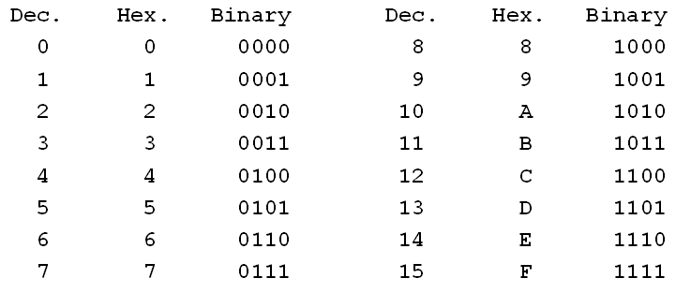
IPv6 Address Notation
2001:0DB8:AAAA:1111:0000:0000:0000:0100
2001 : 0DB8 : AAAA : 1111 : 0000 : 0000 : 0000 : 0100
16 bits
1
16 bits
2
16 bits
3
16 bits
4
16 bits
5
16 bits
6
16 bits
7
16 bits
8
IPv6 addresses are 128-bit addresses represented in:
Hexadecimal: 1 hex digit = 4 bits
Eight 16-bit segments or “hextets” (not a formal term) between 0000 and FFFF
Separated by colons
Reading and subnetting IPv6 is easier than IPv4…. Really!
Notes:
[RFC4291] does not mention any preference of uppercase or lowercase.
The RFC 5952 recommendation that SHOULD be followed is that characters be represented in lower text by systems when generating an
address to be represented as text, but all implementations MUST accept and be able to handle any legitimate [RFC4291] format.

Slide 9
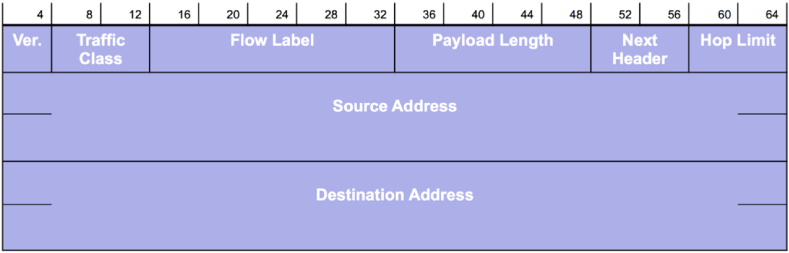
128-bit Address: How Many Is That?
2001:0DB8:AAAA:1111:0000:0000:0000:0100
128 bits

Slide 10
Number of IPv6 Addresses
Number name | Scientific Notation | Number of zeros
1 Thousand | 10³ | 1,000
1 Million | 10⁶ | 1,000,000
1 Billion | 10⁹ | 1,000,000,000
1 Trillion | 10¹² | 1,000,000,000,000
1 Quadrillion | 10¹⁵ | 1,000,000,000,000,000
1 Quintillion | 10¹⁸ | 1,000,000,000,000,000,000
1 Sextillion | 10²¹ | 1,000,000,000,000,000,000,000
1 Septillion | 10²⁴ | 1,000,000,000,000,000,000,000,000
1 Octillion | 10²⁷ | 1,000,000,000,000,000,000,000,000,000
1 Nonillion | 10³⁰ | 1,000,000,000,000,000,000,000,000,000,000
1 Decillion | 10³³ | 1,000,000,000,000,000,000,000,000,000,000,000
1 Undecillion | 10³⁶ | 1,000,000,000,000,000,000,000,000,000,000,000,000
IPv4
4.3 billion
IPv4 addresses:
4.3 billion
IPv6 addresses:
340 undecillion
IPv6
340 undecillion
340,282,366,920,938,463,463,374,607,431,768,211,456

Slide 11

Number of IPv6 Addresses
340 undecillion addesses or …
340 trillion trillion trillion addresses or as some people have put it….
“10 nonillion addresses for every person on earth” or….”
“655,570,793,348,866,943,898,599 addresses for every square meter of the Earth's surface.”
Notes:
So we could assign an IPV6 address to EVERY ATOM ON THE SURFACE OF THE EARTH, and still have enough addresses left to do another 100+ earths.
655 sextillion
We’re not going to run out!
But Rick, they said that about IPv4.
I won’t be doing the videos for IPv6. ☺
Graphic : http://www.cisco.com/web/tomorrow-starts-here/index.html

Slide 12
Two Rules for Compressing IPv6 Addresses
Rule 1: Omitting Leading 0s
Two rules for reducing the size of written IPv6 addresses.
First rule: Leading zeroes in any 16-bit segment do not have to be written.
2001 : 0DB8 : 0001 : 1000 : 0000 : 0000 : 0ef0 : bc00
2001 : DB8 : 1 : 1000 : 0 : 0 : ef0 : bc00
2001 : 0DB8 : 010d : 000a : 00dd : c000 : e000 : 0001
2001 : DB8 : 10d : a : dd : c000 : e000 : 1
2001 : 0DB8 : 0000 : 0000 : 0000 : 0000 : 0000 : 0500
2001 : DB8 : 0 : 0 : 0 : 0 : 0 : 500
Notes:
Only leading 0s, not trailing 0s.
Otherwise we wouldn’t know which 0s were omitted – leading 0s, trailing 0s, or both.
By the way, I’m using spaces between the hextets only for readability.

Slide 13
Two Rules for Compressing IPv6 Addresses
Rule 1: Omitting Leading 0s
Only leading 0s can be excluded, trailing 0s must be included.
Or leads to ambiguity…
2001 : 0DB8 : ab : 1234 : 5678: 9abcd: ef12: 3456
2001 : 0DB8 : 00ab : 1234 : 5678: 9abcd: ef12: 3456
2001 : 0DB8 : ab00 : 1234 : 5678: 9abcd: ef12: 3456
2001 : 0DB8 : 0ab0 : 1234 : 5678: 9abcd: ef12: 3456
?
Notes:
Only leading 0s, not trailing 0s.
Otherwise we wouldn’t know which 0s were omitted – leading 0s, trailing 0s, or both.
By the way, I’m using spaces between the hextets only for readability.

Slide 14
Two Rules for Compressing IPv6 Addresses
Rule 2: Double Colon ::
The second rule can reduce this address even further:
Second rule: Any single, contiguous string of one or more 16-bit segments consisting of all zeroes can be represented with a double colon (::).
2001 : 0DB8 : 1000 : 0000 : 0000 : 0000 : 0000 : 0001
2001 : DB8 : 1000 : : 1
2001:DB8:1000::1
First rule
Second rule
First rule

Slide 15
Rule 2: Double Colon :: Choices
Only a single contiguous string of all-zero segments can be represented with a double colon.
Although the rule states that both of these are correct…
2001 : DB8 : 0000 : 0000 : 1234 : 0000 : 0000 : 5678
2001 : DB8 :: 1234 : 0 : 0 : 5678
2001 : DB8 : 0 : 0 : 1234 :: 5678
RFC 5952
or
… RFC 5952 states that the longest string of zeroes must be replaced with the :: and if they are equal then the first string of 0’s should use the :: representation.
Maximum reduction of the address is known as the “compressed” format.
Notes:
RFC 5952 does state that the longest string of zeroes must be replaced w/ the :: and if they are equal then the first string of 0’s should use the :: representation
RFC 5952 A Recommendation for IPv6 Address Text Representation provides clarity on how addresses should be represented

Slide 16
Rule 2: Double Colon :: Only Once
Using the double colon more than once in an IPv6 address can create ambiguity because of the ambiguity in the number of 0s.
2001:DB8::1234::5678
2001:DB8:0000:0000:0000:1234:0000:5678
2001:DB8:0000:0000:1234:0000:0000:5678
2001:DB8:0000:1234:0000:0000:0000:5678

Slide 17
3.3: The IPv6 Prefix Length

Slide 18
IPv4: Subnet Mask and Prefix Length
Prefix Subnet
Binary Mask Length Mask
11111111 00000000 00000000 00000000 /8 255.0.0.0
11111111 10000000 00000000 00000000 /9 255.128.0.0
11111111 11000000 00000000 00000000 /10 255.192.0.0
11111111 11100000 00000000 00000000 /11 255.224.0.0
11111111 11110000 00000000 00000000 /12 255.240.0.0
11111111 11111000 00000000 00000000 /13 255.248.0.0
11111111 11111100 00000000 00000000 /14 255.252.0.0
11111111 11111110 00000000 00000000 /15 255.254.0.0
11111111 11111111 00000000 00000000 /16 255.255.0.0
11111111 11111111 10000000 00000000 /17 255.255.128.0
11111111 11111111 11000000 00000000 /18 255.255.192.0
11111111 11111111 11100000 00000000 /19 255.255.224.0
11111111 11111111 11110000 00000000 /20 255.255.240.0
11111111 11111111 11111000 00000000 /21 255.255.248.0
11111111 11111111 11111100 00000000 /22 255.255.252.0
11111111 11111111 11111110 00000000 /23 255.255.254.0
11111111 11111111 11111111 00000000 /24 255.255.255.0
11111111 11111111 11111111 10000000 /25 255.255.255.128
11111111 11111111 11111111 11000000 /26 255.255.255.192
11111111 11111111 11111111 11100000 /27 255.255.255.224
11111111 11111111 11111111 11110000 /28 255.255.255.240
11111111 11111111 11111111 11111000 /29 255.255.255.248
11111111 11111111 11111111 11111100 /30 255.255.255.252
11111111 11111111 11111111 11111110 /31 255.255.255.254
11111111 11111111 11111111 11111111 /32 255.255.255.255
IPv4
Network portion
Prefix
Host portion
IPv4, the prefix, the network portion of the address, can be identified by:
Dotted decimal subnet mask
Prefix length
The number of bits in the prefix or network portion of the address.
32 bits
Notes:
The prefix length is the number of bits set in the subnet mask; for instance, if the subnet mask is 255.255.255.0, there are 24 1’s in the binary version of the subnet mask, so the prefix length is 24 bits.

Slide 19
IPv6 Prefix Length
IPv6 prefixes are always identified by prefix length.
Prefix length - The number of bits in the Prefix portion of the address (equivalent to the network portion of the address).
Separates the Prefix portion from the Interface ID (equivalent to the host portion of the address).
Written immediately following the IPv6 address, usually no space.
The prefix length does not have to fall on a nibble (4-bit) boundary.
Prefix
Interface ID
2001:0DB8:0000:0000:0000:0000:0000:0001
Prefix length
/32
/48
/52
/56
/64
/60
Notes:
A nibble is 4 bits

Slide 20
IPv6 Prefix Length
The prefix length does not have to fall on a nibble boundary.
What about a /62?
Prefix lengths can fall within a nibble – but with with such a large address space this is usually not required or recommended.
bits
0000
Prefix
Interface ID
2001:0DB8:0000:0000:0000:0000:0000:0001
/62
/64
Prefix length
/60
Notes:
We take another look at this with subnetting IPv6 in Lesson 4

Slide 21
IPv6 Prefix Length
Prefix (network address) examples:
2001:DB8::/32
2001:DB8:1::/48
2001:DB8:CAFE::/48
2001:DB8:CAFE:1::/64
2001:DB8:CAFE:1234::/64
You will become more familiar with these addresses.
In Lesson 4 we will see how easy IPv6 addresses are to use.
Really!
IPv6 device address examples:
2001:DB8:CAFE::1/48
2001:DB8:CAFE::99:2/48
2001:DB8:CAFE:1::100/64
2001:DB8:CAFE:1:AAAA:BBBB:CCCC:DDDD/64
Notes:
You will become more familiar with these addresses – other lessons and by using IPv6

Slide 22
3.4: Overview of IPv6 Address Types

Slide 23
IPv6 Address Types…. Road Map
IPv6 Addresses
Lesson 6
Unicast
Multicast
Anycast
Assigned
Solicited Node
FF00::/8
FF02::1:FF00:0000/104
Lesson 4
Lesson 5
Global Unicast
Link-Local
Loopback
Unspecified
Unique Local
Embedded IPv4
2000::/3
FE80::/10
::1/128
::/128
FC00::/7
::/80
IPv6 does not have a “broadcast” address.
Notes:
RFC 6724 - Default Address Selection for IPv6 (includes IPv4)
Much more later other lessons, and used throughout this video series
IPv6 does not have a broadcast address however, there is an all-IPv6-devices multicast. We will explain how that is different in Lesson 6

Slide 24
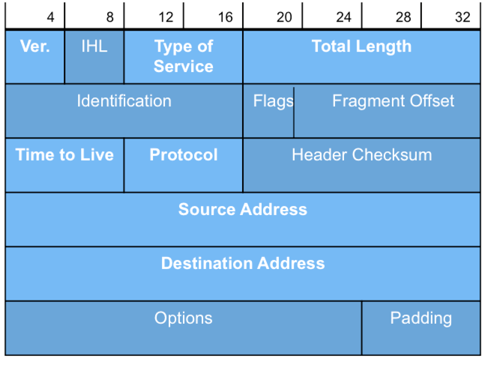
IPv6 Source and Destination Addresses
IPv6 Source – Always a unicast
IPv6 Destination – Unicast, multicast or anycast.
IPv4
IPv6
Notes:
Much more in later lessons

Slide 25
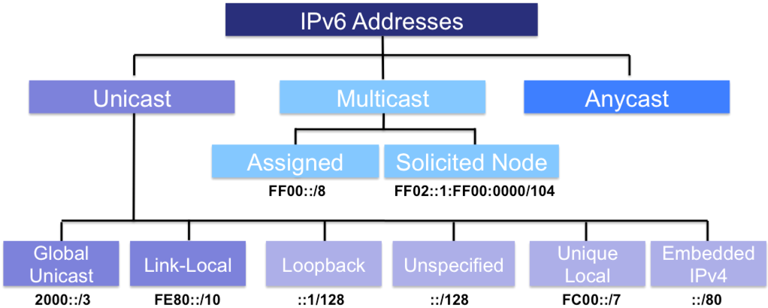
Unicast Addresses
IPv6 Internet
Global Unicast Address (GUA) – More in Lesson 4
2000::/3 (Range 2000::/64 thru 3fff:fff:fff:fff::/64)
Globally unique, routable, similar to public IPv4 addresses
2001:DB8::/32 - RFC 2839 reserves this range of addresses for documentation
These are the addresses we will be referring to the most.
Notes:
More in lesson 4

Slide 26
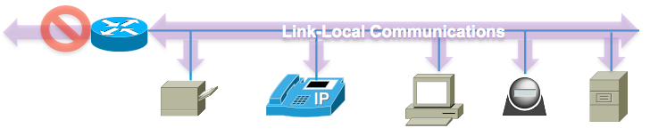
Unicast Addresses
Link-local Unicast – More in Lesson 5
FE80::/10 (First hextet: FE80::10 to FEBF::/10)
Not routable off the link (link = network or subnet)
Unique only on the link
An IPv6 device must have at least a link-local address.
Used by:
Hosts to communicate to the IPv6 network before it has a GUA.
Router’s link-local address is used by hosts as the default gateway address.
Adjacent routers to exchange routing updates.
Next-hop addresses in IPv6 routing tables.
Notes:
More in lesson 4

Slide 27
Unicast Addresses
Loopback Address
::1/128
Used by a node to send an IPv6 packet to itself, typically when testing the TCP/IP stack
Same functionality as IPv4 loopback 127.0.0.1
Not routable.
Unspecified Address
:: (all-0s)
Indicates the absence or anonymity of an IPv6 address (RS source address)
Used as a source IPv6 address during duplicate address detection process
Notes:
You don’t need to know who I am, just send out your Router Advertisement to all IPv6 devices on the link.
The primary use of the unspecified address is the neighbor discovery process (RFC 4291). Specifically during the duplicate address detection process. Can also be used as a source address in a router solicitation message (RFC 4861). Router advertisement message should always have a legitimate IPv6 address for a source address.

Slide 28
Unicast Addresses
Note: Site local addresses (FEC0::/10) has been deprecated.
Unique Local Address
FC00::/7 (First hextet: FC00::7 to FDFF::/7)
Similar to RFC 1918 IPv4 addresses but not meant to be translated to a global unicast (for security purposes)
Should not be routable in the global Internet.
To be used in a more limited area such as within a site or devices inaccessible from the global Internet.
FC00::/7 – 1111 110x (x = local flag bit)
FC00::/8 (x = 0) - /48 prefix assigned using RFC 4193 algorithm (dormant)
FD00::/8 (x = 1) - /48 prefix locally locally assigned.
Notes:
https://www.apnic.net/__data/assets/pdf_file/0019/33427/arin-vx-v6-ula.pdf
Not analogous to RFC 1918 addresses because RFC 1918 addresses were created as a result of lack of IPv4 addresses. That is not the case for ULA (pronounced ULA) addresses.
Locally Defined Addresses: FD00::/8
• Assignment type = 1
• Self selection of a /48 prefix
• No coordinated registration records maintained
• No global AAAA or PTR DNS records
• Centrally Assigned Addresses: FC00::/8
• Assignment type = 0
• Defined as a set of prefixes to be assigned by a common
registry function
• Uniquely assigned address prefixes
• May be in the global DNS, but not in the global IPv6 routing
table
• Current status appears to be dormant within the IETF IPv6
Working Group

Slide 29
Unicast Addresses
All 0s
96 bits
IPv4 Address
32 bits
Embedded IPv4 Address
Was used by dual-stack devices that support both IPv4 and IPv6.
Rarely used and is now deprecated.
Other transition methods now used when required to send IPv6 packets over IPv4-only networks, such as tunneling and NAT64.

Slide 30
Multicast Addresses
Multicast Addresses - Used to send a single packet to multiple destinations simultaneously (one-to-many).
Assigned Multicast Address – More in Lesson 6
FF02::/8 – Multicast addresses with link-local scope
Similar to assigned multicast addresses for IPv4.
FF02::1 – All IPv6 devices
FF02::2 – All IPv6 routers
FF02::5 – All OSPFv3 routers

Slide 31

Multicast Addresses
Much more in Lesson 6 Multicast Addresses
Solicited Node Multicast Address – More in Lesson 6
FF02:0:0:0:0:1:FF00::/104 (FF02::1:FFxx:xxxx)
Automatically created using a special mapping of the device’s unicast address.
Every global unicast and link-local unicast has an associated solicited node multicast address.
Used during ICMPv6 neighbor discovery address resolution (ARP in IPv4)

Slide 32
Anycast Addresses
Best path selected by router
2001:DB8:A:B::1
2001:DB8:A:B::1
2001:DB8:A:B::1
Anycast Address
A unicast address that is assigned to more than one interface (typically different devices).
Similar to IPv4 anycast, a packet sent to an anycast address is routed to the “nearest” interface having that address, according to the router’s routing table

Slide 33
Summary: IPv6 Address Types
IPv6 Addresses
Lesson 6
Unicast
Multicast
Anycast
Assigned
Solicited Node
FF00::/8
FF02::1:FF00:0000/104
Lesson 4
Lesson 5
Global Unicast
Link-Local
Loopback
Unspecified
Unique Local
Embedded IPv4
2000::/3
FE80::/10
::1/128
::/128
FC00::/7
::/80
Notes:
Much more later other lessons, and used throughout this video series

Slide 34
For more information please check out my Cisco Press book and video series:
IPv6 Fundamentals: A Straightforward Approach to Understanding IPv6
By Rick Graziani
ISBN-10: 1-58714-313-5
IPv6 Fundamentals LiveLessons: A Straightforward Approach to Understanding IPv6
By Rick Graziani
ISBN-10: 1-58720-457-6

Slide 35
3: IPv6 Address Representation and Address Types
Rick Graziani
Cabrillo College
Rick.Graziani@cabrillo.edu

